Slide 1

servers
Notes:
Quick intro to serverless
Maturity model
Wardley map, discussion on utilities
Benefits / ideas about how this changes everything
Adoption ideas
Focus on high value changes
Challenges to implement
Experiences at GameStop

Slide 2



Jack Warner
jack.warner@parivedasolutions.com
/jackwarner
Phillip Manwaring
phillip.manwaring@parivedasolutions.com
/manwaring

Slide 3


f(n) + +

Slide 4

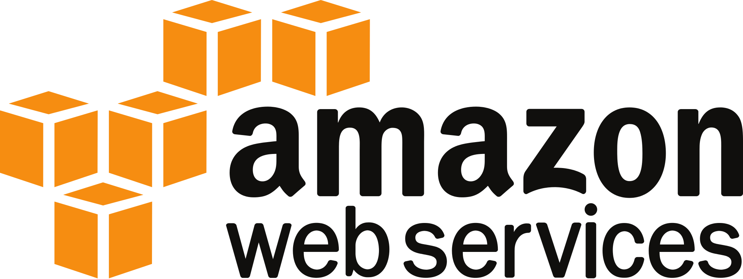
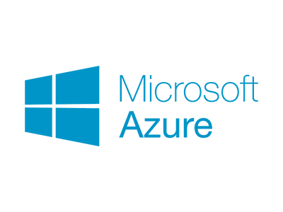


f(n) + +

Slide 5
Your business doesn’t have technology problems

Slide 6


Slide 7
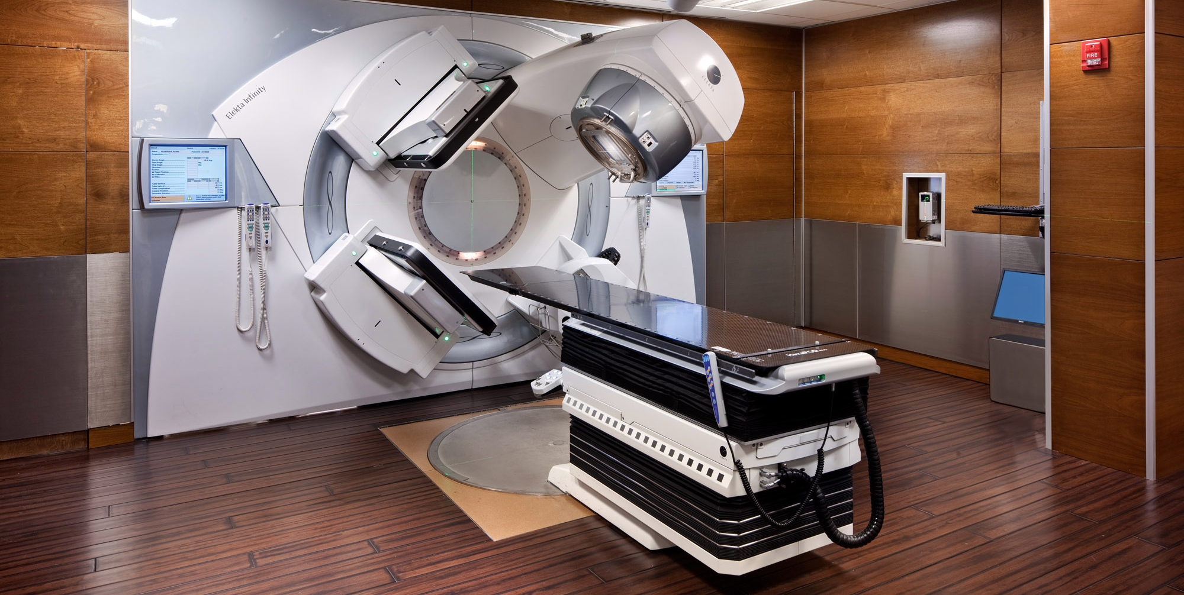

Slide 8
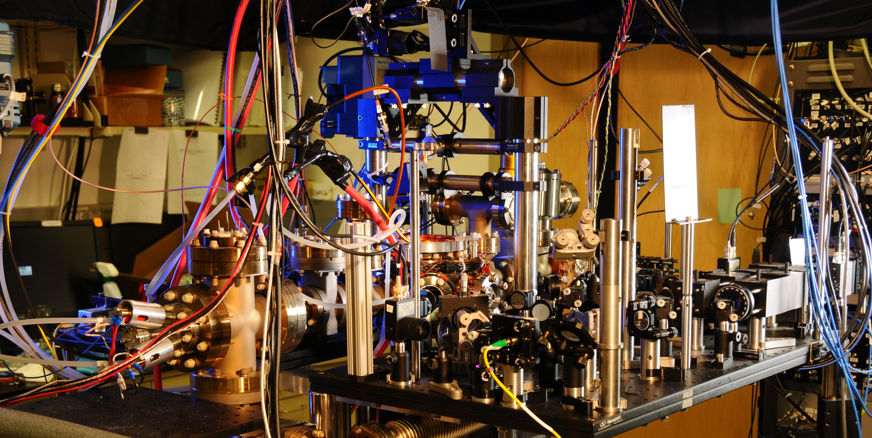
Notes:
Spanner ( Google’s modern relational database management systems that seek to provide the same scalable performance of NoSQL systems for online transaction processing (OLTP) read-write workloads while still maintaining the ACID guarantees of a traditional database system.^{[)1][2][3])}

Slide 9
You still have problems
Notes:
Staying relevant (MySpace) - Facebook
Scaling globally (?)
Reaching new demographics (Netflix launches to 60 countries)
Avoiding political pitfalls
Creating new products/services
Staying price competitive
Adapting to change (Blockbuster)

Slide 10


Slide 11


Slide 12


Slide 13
You don’t have technology problems
Solving technology problems isn’t your business

Slide 14





20 - 40%
40 - 60%
60 - 80%

Slide 15
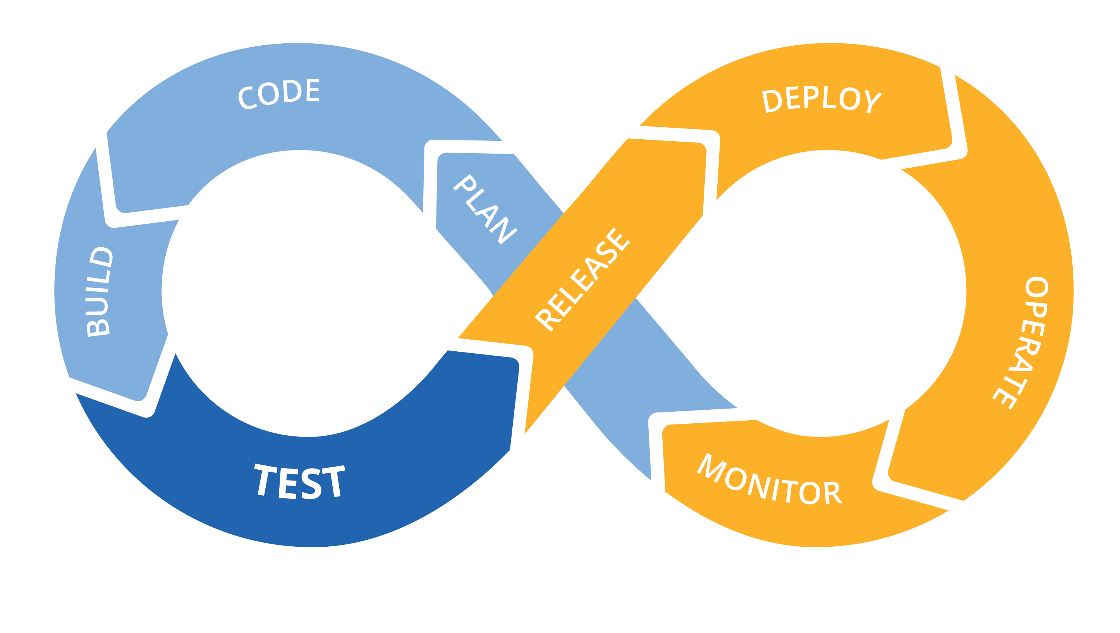
We have nothing new to offer
Notes:
Infrastructure as code
CI/CD for increased speed and stability
Monoliths to microservices to functions
Small teams, highly cohesive and loosely coupled
Only pay for what you use
Polyglot – the right language/framework for the job

Slide 16
Energy
 | Time

Slide 17



Energy
 | Time
Activation energy

Slide 18
Technology problems
 | Time
Difficulty of the change
Time required for change

Slide 19
Technology problems
 | Time
Catalysts change the equation

Slide 20
Technology problems
 | Time
Serverless
is the catalyst
Catalysts change the equation

Slide 21

(not very) Bold predictions
Notes:
True variable cost computing
Time to market goes from months or weeks to days or hours
Built in support for things you should be doing already
Infrastructure as code
API driven development and data analysis to inform product development
Small teams
It’s like magic – haven’t met a developer who didn’t love it
Easy to use, easy to experiment with
Low cost to learn, develop with, experiment with – only cost is time, no infrastructure or hosting
Starts a chain reaction across your organization

Slide 22


Slide 23


Slide 24

Cloud adoption & automation

Slide 25

Faster Time-to-Market

Slide 26


Slide 27

Small, product focused teams

Slide 28

Notes:
If relying on large efforts to change the organization and add business value, putting all your eggs in a single basket
Implies being able to clearly see the end from the beginning
Huge opportunity cost
Feel your way along and change to what’s working better

Slide 29

Data driven decision making

Slide 30
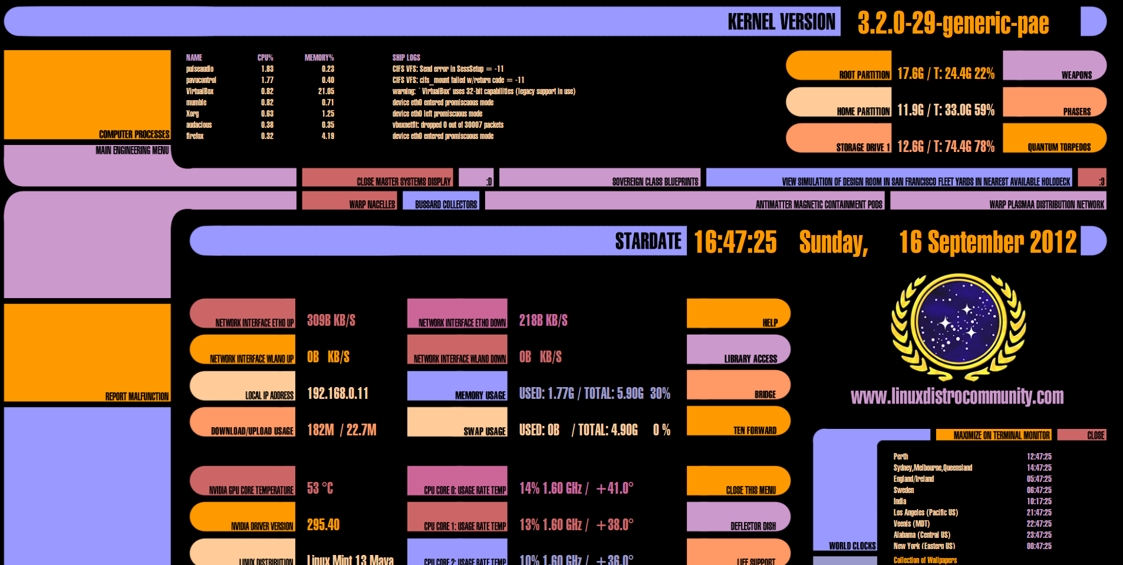


Slide 31


Slide 32

The End of Brooks’s Law

Slide 33



Slide 34
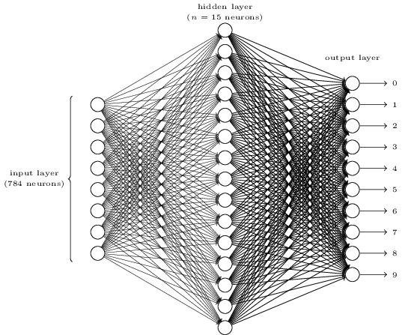
Serverless Usage Data + ML - Product Self-Assembly

Slide 36
? ? ?

Slide 37

Technology problems
 | Time

Slide 38


Technology problems
 | Time
Notes:
Serverless is a unique opportunity to free your people’s brains to solve business problems instead of IT problems

Slide 39




Notes:
If the people you’ve hired have built a mature DevOps and cloud company they already know about serverless and love it, and probably are already using it
If the people you’ve hired haven’t built a mature DevOps and cloud company
If they would like to but can’t for whatever reasons, they likely know about serverless and have used it on side projects and love it
If they aren’t pushing for DevOps or cloud there’s a good chance they don’t know anything about serverless (or DevOps practices in general)
Know the group you are working with

Slide 40








